Slide 1
MuscleHub A/B fitness test
Evaluating if fitness tests are being intimidating for visitors

Slide 2
Background
This evaluation is based on the impression that a number of possible clients are intimidated by the initial fitness test currently being used.
As an alternative to this a second option for greeting new clients is to be evaluated during a test period. The new visitors will be divided into two groups.
Group A was still asked to take a fitness test with a personal trainer
Group B skipped the fitness test and proceed directly to the application
Evaluations was done on how many in each group sent an application and how many of these went on to purchase a membership.
Finally we evaluated how many of the total A+B groups purchased a membership

Slide 3
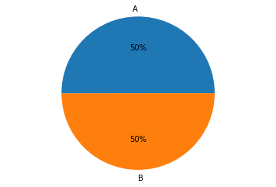
Base data
During the test period a total of 5004 visitors came by MusclHub
These where divided into two almost equal sets A and B. A counting 2504 and B counting 2500

Slide 4
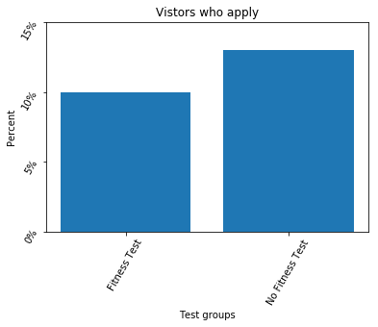
Applications from each group
We got 250 applications from group A
We got 325 applications from group B
Using a Chi-squared test we found a p-value of 0.001 .This is far below 0.05 and we consider that there is a significant statistical difference between the two groups

Slide 5
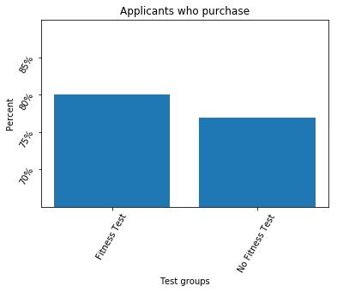
Purchases among those who picked up an application
We got 200 purchases from group A
We got 250 purchases from group B
Using a Chi-squared test we found a p-value of 0.433 .This is far above 0.05 and we consider that there is not a significant statistical difference between the two groups

Slide 6
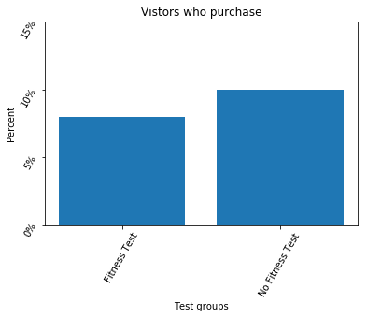
Purchases among the complete set of visitors
We got 250 purchases from group A out of
a total of 2504 in group A
We got 250 purchases from group B out of
a total of 2500 in group B
Using a Chi-squared test we found a p-value of 0.015 .This is well below 0.05 and we consider that there is a significant statistical difference between the two groups

Slide 7
Conclusion and recommendation
Based the interviews and the test results supports Janet’s assumption that not all applicants appreciate the initial fineness test.
As such it’s recommended that MuscleHub establishes a voluntary process where the client get an offer for a fitness test if he/she would like ift for their own benefit.
By doing this it is likely that MusclHub get more paying members.

